Slide 1


Tapestry Link User Guide
Elizabeth Perkins, Provider Relations Manager
Proprietary & Confidential Information

Slide 2
Table of Contents
Registration and Account Settings
Registration
Pre-login Features
Log-In
Home Screen
Account Settings
Administrative Functions
Member Details
Selecting a Member
Member Information
Member Coverage & Benefits

Slide 3
Table of Contents-cont’d
Provider Search
Provider Search
Claims
Claims by Member
Claims Search
Claim Inquiries
In Basket
In Basket
My Messages

Slide 4
Table of Contents-cont’d
In Basket-cont’d
In Basket-Customer Service Request
My Out Basket
Prior Auth Routing
No Auth Needed
Evicore
Guiding Care
Interqual
Authorizations by Member

Slide 5
Registration
Our established users will receive an email with their new username and password 3-5 days prior to the go-live date of January 1, 2022.
This will provide instructions on how to enter the portal for the first time.

Slide 6
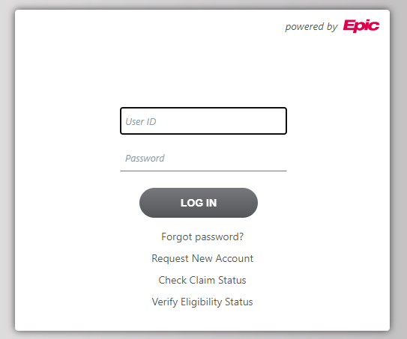
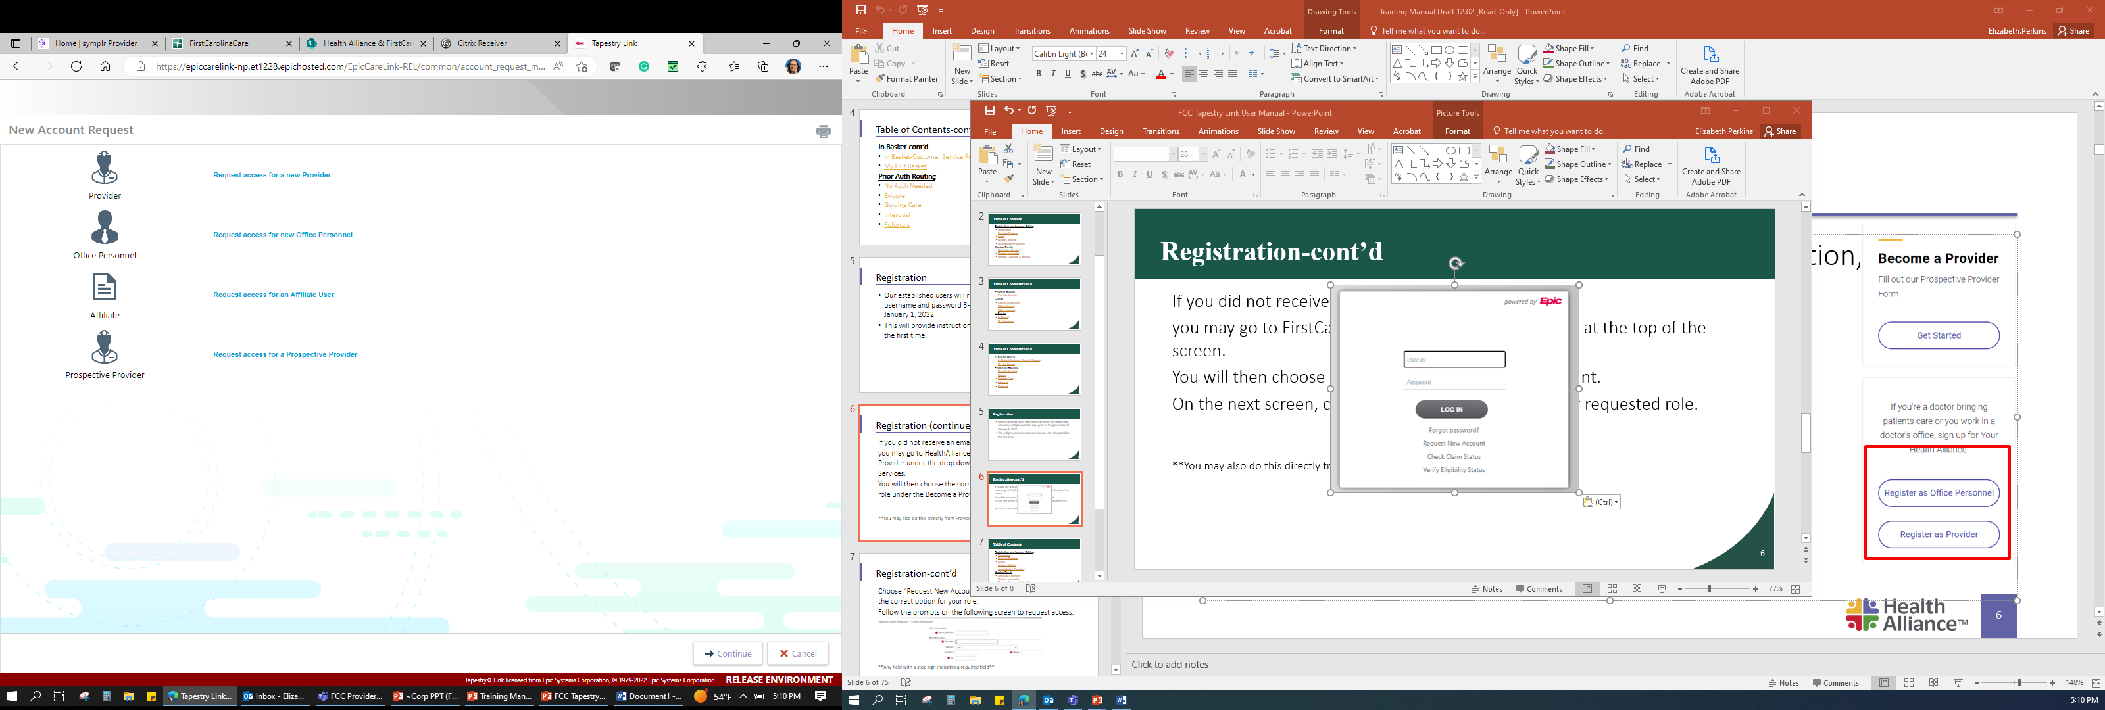
Registration-cont’d
If you did not receive an email with this information,
you may go to FirstCarolinaCare.com and click “Log In”
at the top of the screen.
You will then choose the option to Request New Account.
On the next screen, choose the correct option for your
requested role.

Slide 7
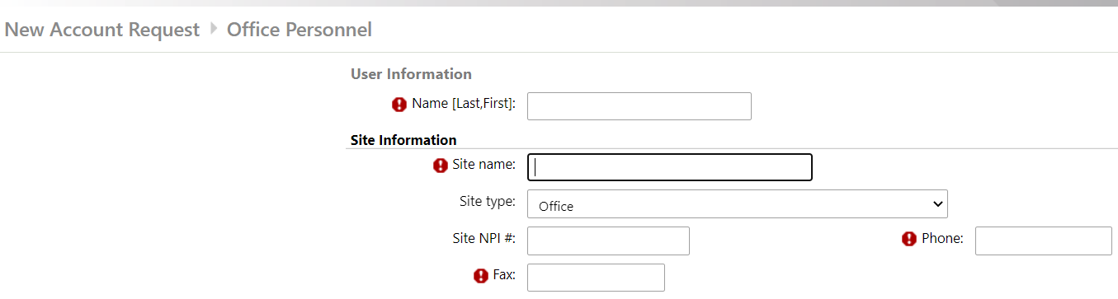
Registration-cont’d
Follow the prompts on the following screen to request access.
**Any field with a stop sign indicates a required field**

Slide 8
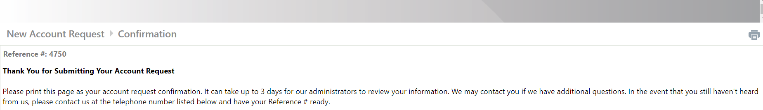
Registration-cont’d
Once registration is complete, you will receive a confirmation that we’ve received your request. Please allow 2-4 business days for portal access to be granted.
If you need immediate access to enter authorization requests, you may contact Customer Support at (800) 481-1092
Monday-Friday 8:00 am to 5:00 pm EST.

Slide 9
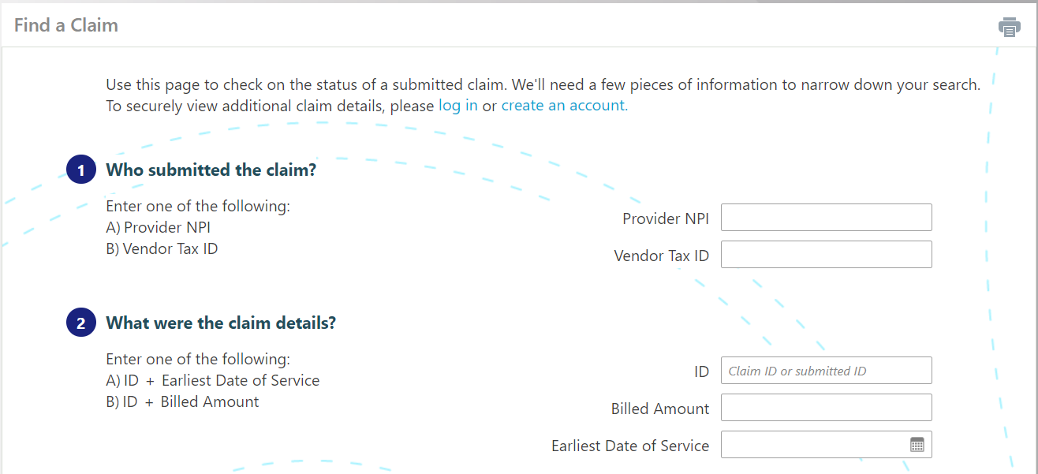
Pre-login Features – Check Claim Status
You may check claim status without logging into the portal with basic claim information such as Tax ID or NPI and Claim + Earliest Date of Service or Claim ID + Billed Amount.

Slide 10
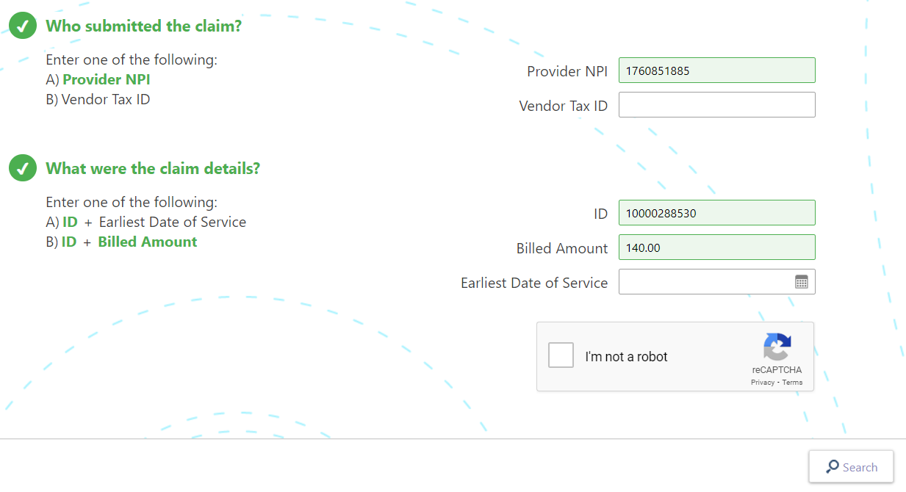
Pre-login Features – Check Claim Status-cont’d
When you have entered the information needed to search the claim, the numbers on the left will turn to check marks.
Once you’ve received two check
marks, you will click I’m not a
robot and then Search.

Slide 11
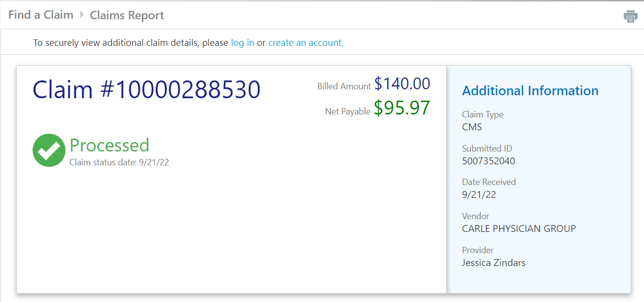
Pre-login Features – Check Claim Status-cont’d
If a claim is found based on the previous criteria, you will receive basic claim details. For more detailed claims information, you would need to log in or create an account.

Slide 12
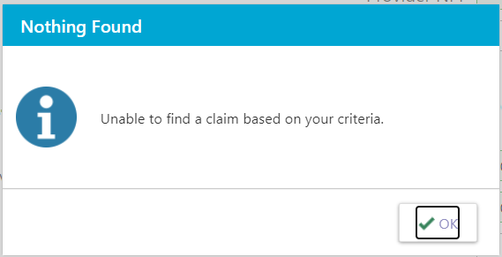
Pre-login Features – Check Claim Status-cont’d
If the claim is not located based on the criteria, you will receive a notification that nothing has been found.

Slide 13
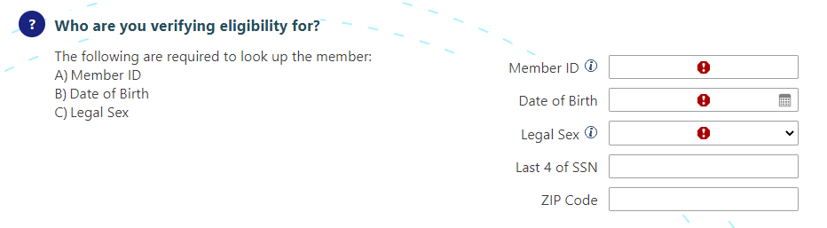
Pre-login Features – Verify Eligibility
You can verify a member’s eligibility with their member ID number, date of birth, and legal sex.

Slide 14
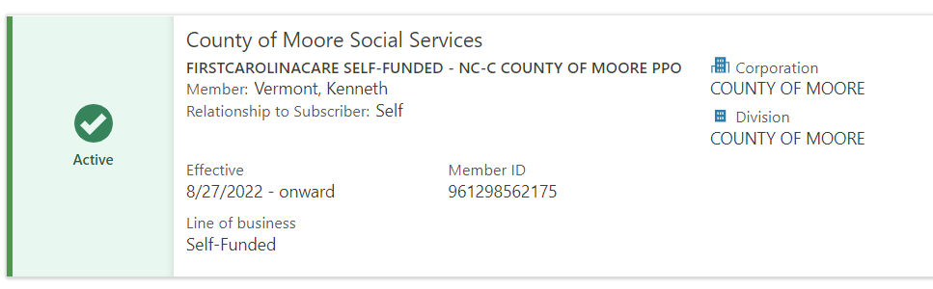
Pre-login Features – Verify Eligibility-cont’d
If a patient is located based on the criteria entered, you will receive basic eligibility information for the patient. If you need more detailed benefit information, a log in would be required.

Slide 15
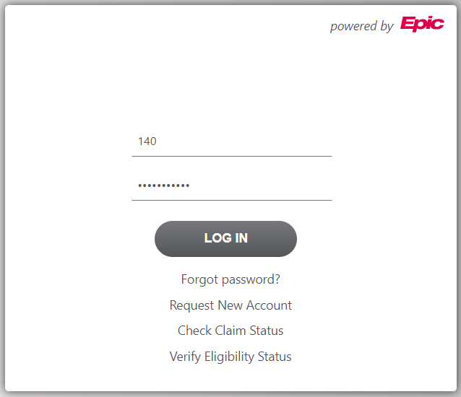
Log In
At the login screen, you will enter your User ID and Password and click Log In.

Slide 16
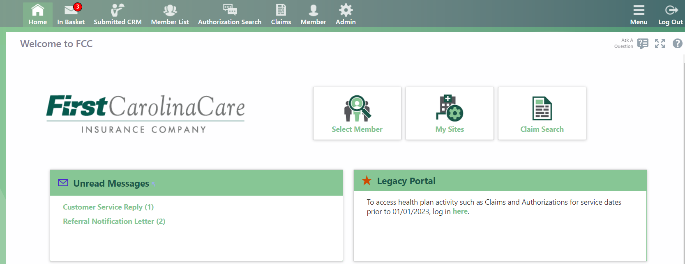
Home Screen
From the Home Screen you will see several quick access buttons as well as the full menu across the top of the screen.

Slide 17
Home Screen-cont’d
The “Ask A Question” and “?” buttons a page specific and provide quick and easy access to additional assistance.

Slide 18
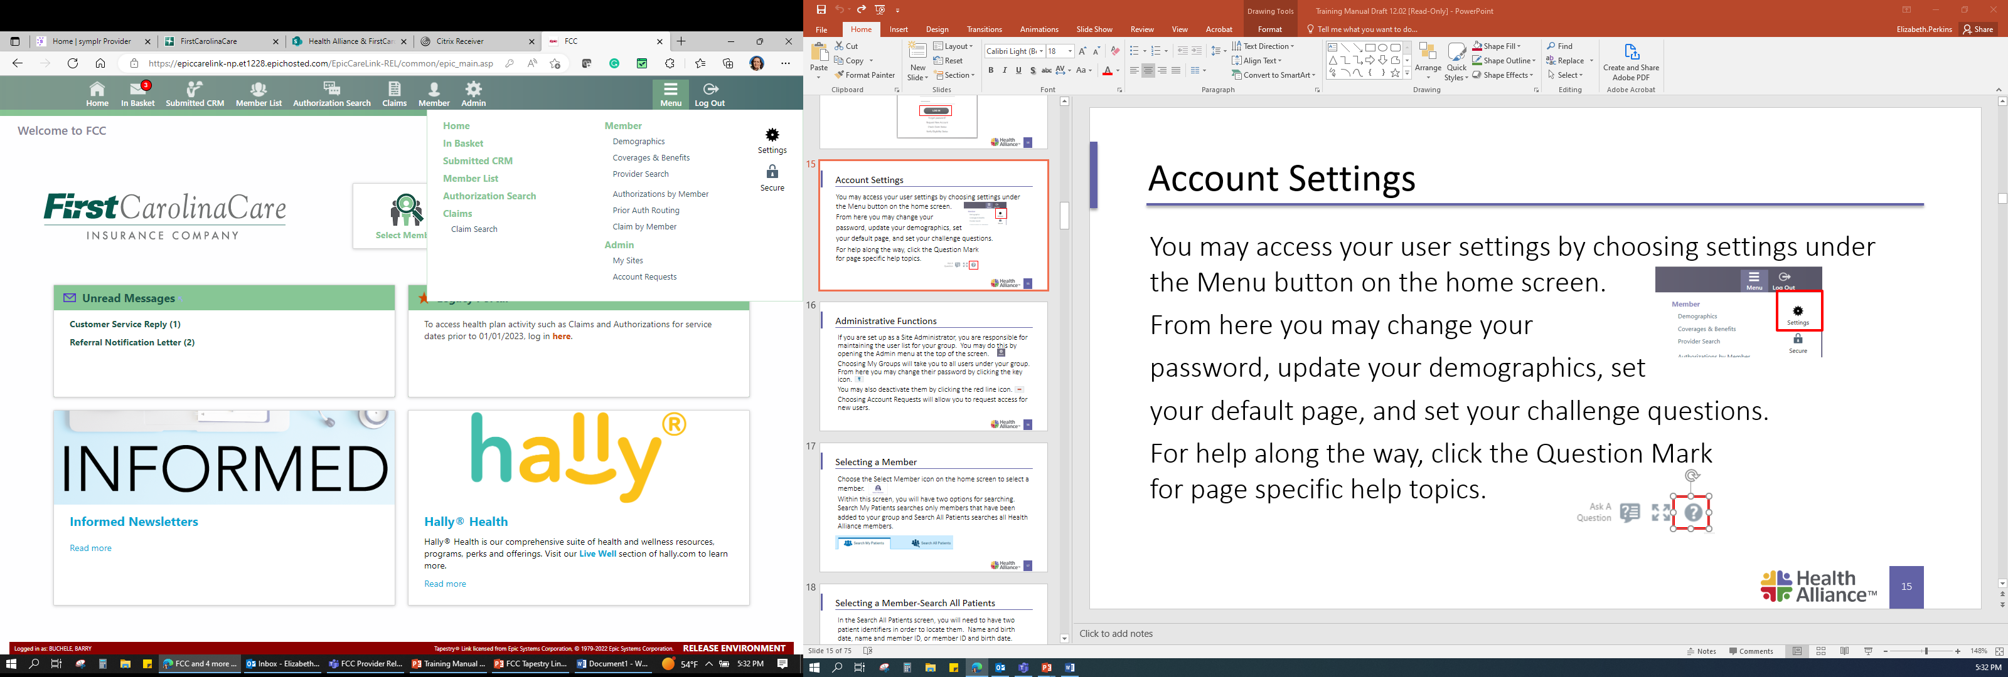
Account Settings
You may access your user settings by choosing settings under the Menu button on the home screen.
From here you may change your password, update your demographics, set your default page, and set your challenge questions.

Slide 19


Administrative Functions
If you are set up as a Site Administrator, you are responsible for maintaining the user list for your group. You may do this by opening the Admin menu at the top of the screen.
Choosing My Groups will take you to all users under your group. From here you may change their password by clicking the key icon.
You may also deactivate them by clicking the red line icon.
Choosing Account Requests will allow you to request access for new users.

Slide 20


Selecting a Member
Choose the Select Member icon on the home screen to select a member.
Within this screen, you will have two options for searching. Search My Patients searches only members that have been added to your group and Search All Patients searches all FirstCarolinaCare members.

Slide 21
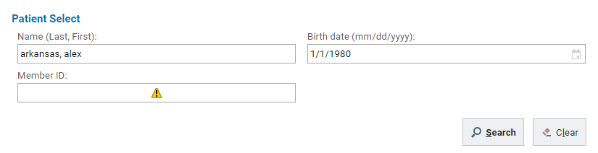
Selecting a Member – Search All Patients
In the Search All Patients screen, you will need to have two patient identifiers in order to locate them. Name and birth date, name and member ID, or member ID and birth date.

Slide 22
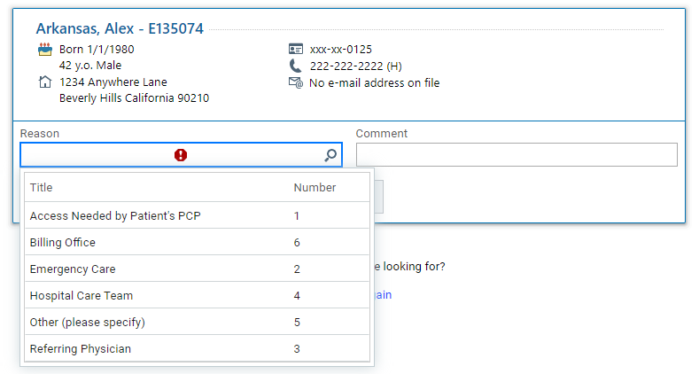
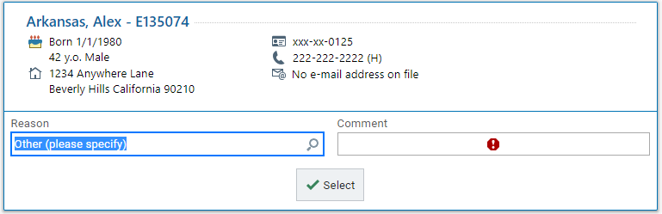
Selecting a Member – Search All Patients-cont’d
Once you have located the member, you will then add the member to your list.
You will choose a reason in the reason field by clicking the magnifying glass for the available choices.
**If you choose Other (please specify) you will need to put a comment in the comment box.**

Slide 23
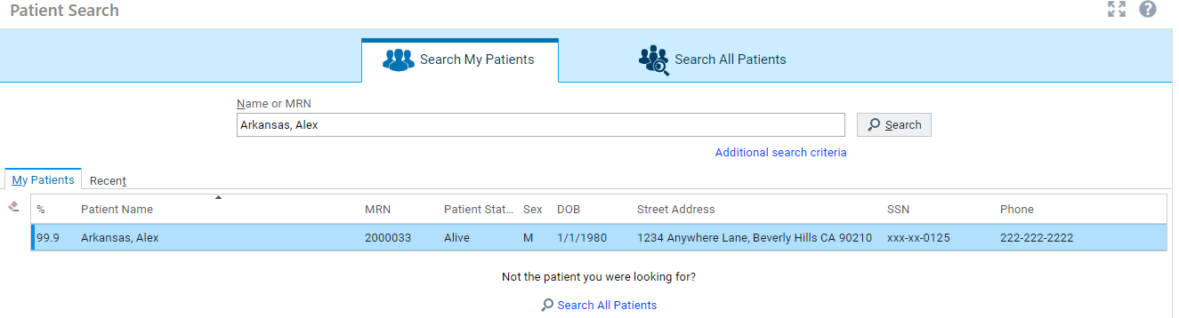
Selecting a Member – Search My Patients
The Search My Patients function will allow you to search only for the patients you have added to your list.
You may type in the patients name and hit search to locate them quickly and efficiently.

Slide 24
Selecting a Member – Search My Patients-cont’d
If you do not immediately locate the member you can add additional search criteria or choose to Search All Patients.

Slide 25
Member Information
Once you have chosen your member, you will now be able to see Demographics, Coverage & Benefits, Provider Search, Authorizations by Member, and Prior Auth Routing.
From this screen, you will also notice you are now attached to the member in the toolbar.
Choosing the … in the toolbar will give more options.

Slide 26
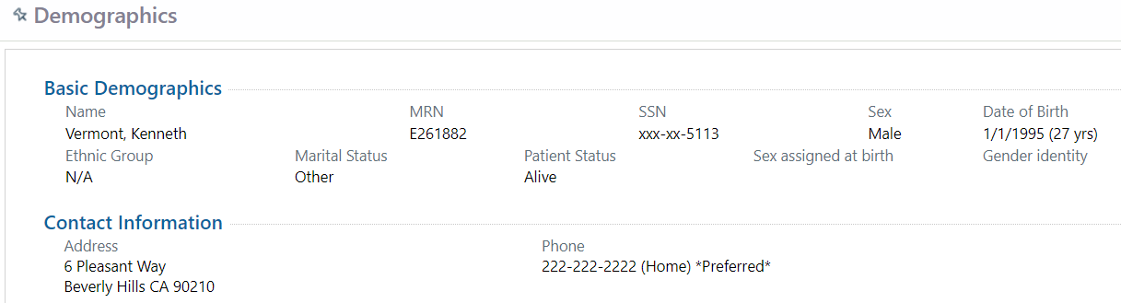
Member Demographics
The Member Demographics screen will give basic demographic information about the member, including address, phone number, sex, and PCP.

Slide 27
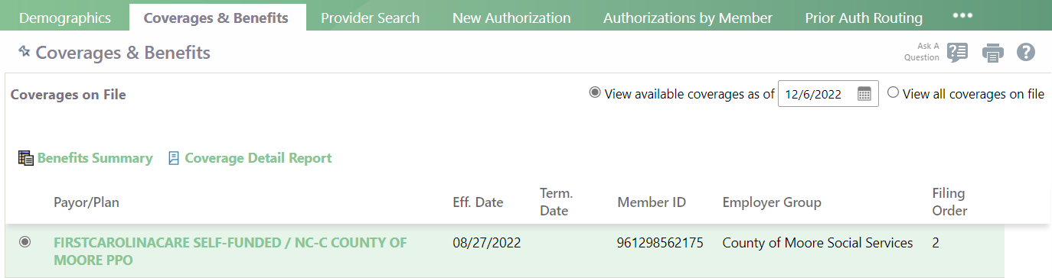
Member Coverage & Benefits
Within the Coverages & Benefits tab you will find active coverage information for the member.
You can find member ID, employer group, effective date, and termination date (if applicable).

Slide 28
Member Coverage & Benefits-cont’d
From this screen you may click the Payor/Plan hyperlink to view benefit details.
You may also view a Coverage Detail Report, the Benefits Summary, and choose to view all coverages on file.

Slide 29
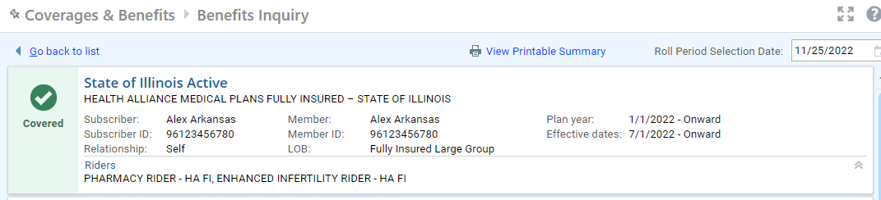
Coverages & Benefits-Benefits Inquiry
Clicking the Payor/Plan hyperlink in the Coverages & Benefits screen will take you to the Coverages & Benefits-Benefits Inquiry screen.
This screen will list more detailed coverage information such as subscriber, relationship to subscriber, and riders.
Notes:
Date selection field for date specific information

Slide 30
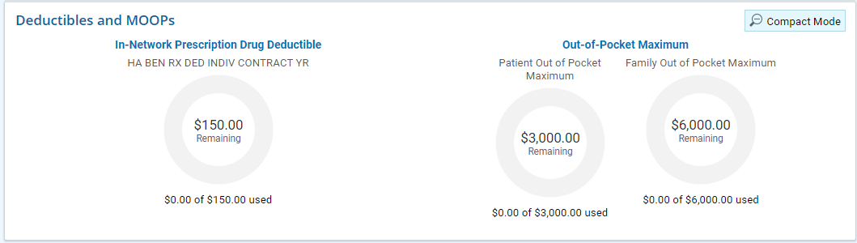
Coverage & Benefits-Benefits Inquiry-cont’d
From this screen you will also see Deductible and Out-of-Pocket Maximum amounts and how much has accumulated towards each.

Slide 31
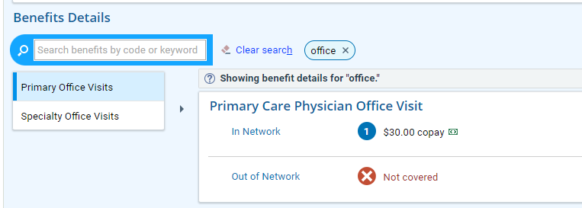
Coverage & Benefits-Benefits Inquiry-cont’d
Scrolling down this screen will list Benefit Details for the plan. You may choose the category you are searching for or type a keyword into the search box.

Slide 32
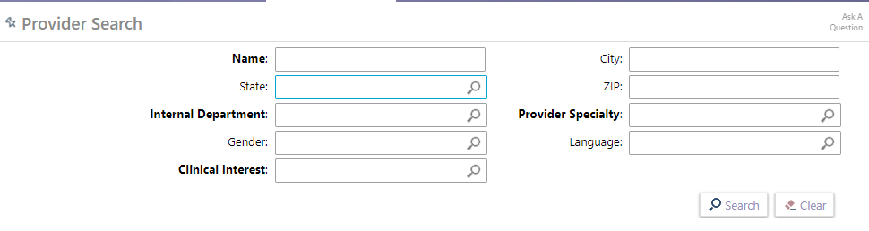
Provider Search
The Provider Search tab will allow you to locate providers that are in network for this patient’s plan for referral and authorization purposes.
You may search by any field that is bold.

Slide 33
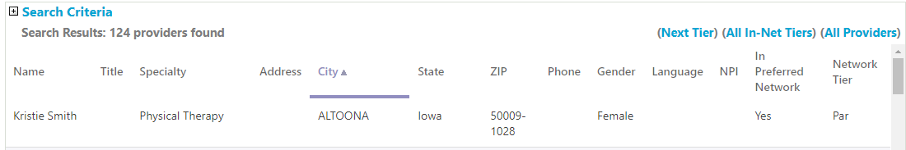
Provider Search-cont’d
When you search by name or specialty, you will receive a list of providers. The first screen you receive will be the providers for which the patient has the highest level of benefits.
You may sort this list by any of the column headers.

Slide 34

Provider Search-cont’d
The search list also includes whether the provider is in network and participating for the patient’s plan.
In Preferred Network=Yes (in network) or No (out of network)
Network Tier=Par (participating), Out of Network (non-participating) or Referral Rqd (tertiary)
You may use the Next Tier, All In-Net Tiers, and All Providers at the top to move between benefit levels.

Slide 35
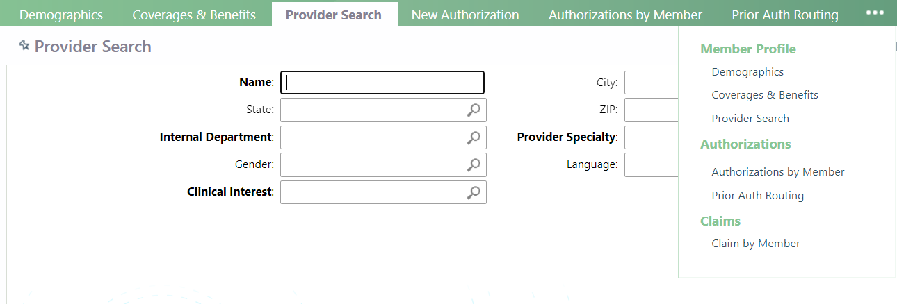
Claims by Member
When you have a member selected, you may choose to view claims only by that member.
The Claims by Member functionality will be within the toolbar and you may need to choose the … to locate this option.

Slide 36
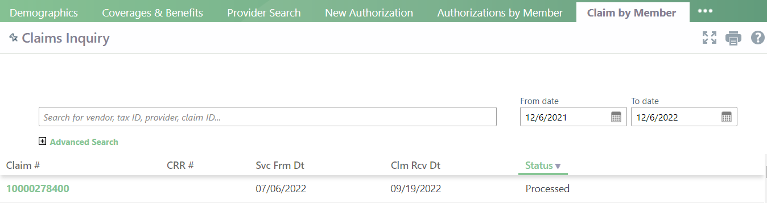
Claims by Member-cont’d
Once you have chosen to view Claims by Member, you will see a list of claims for this member based on the date range that has been selected.
You may click on the Claim # hyperlink to view the claim details.

Slide 37
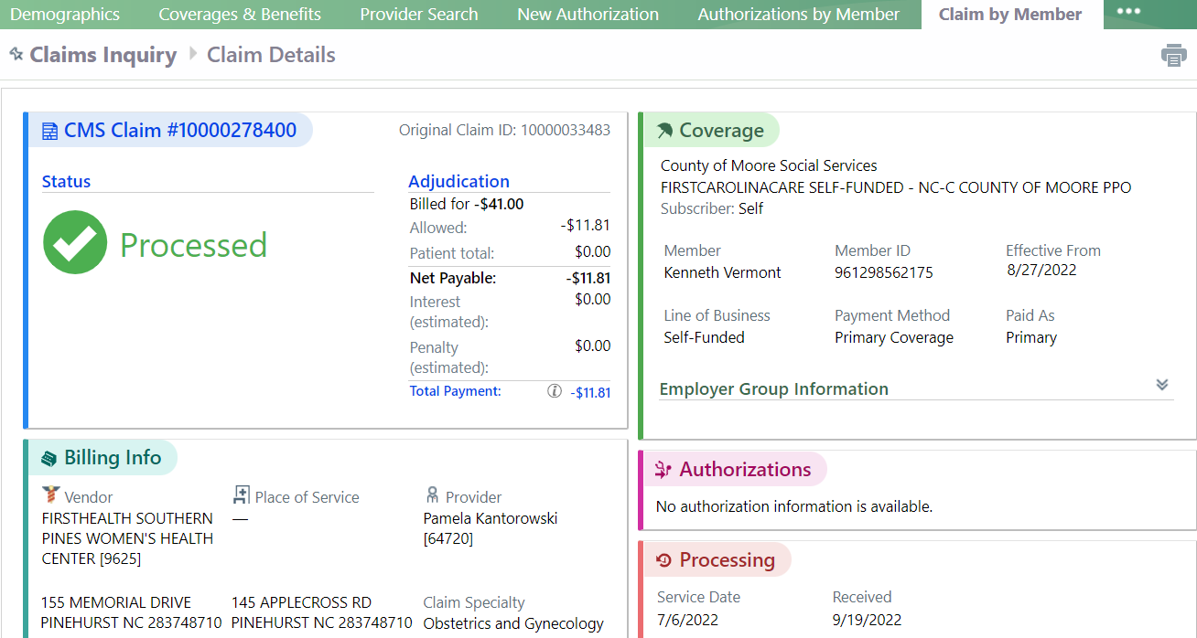
Claims Inquiry-Claims Detail
The Claim Details screen will allow you to view more detailed claim information for the patient including claim status, procedure codes, diagnosis codes, provider information, billed amount, allowed amount, and paid amount.

Slide 38
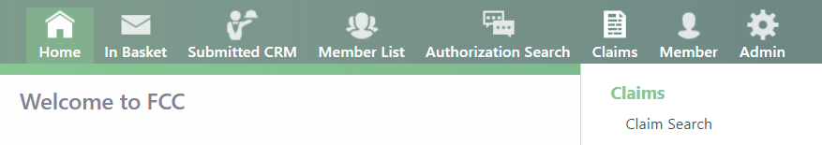
Claims Inquiry-Claims Detail
You may choose Claims Search from the Claims tab on the home screen in order to search for more claims with a larger range of search options.

Slide 39
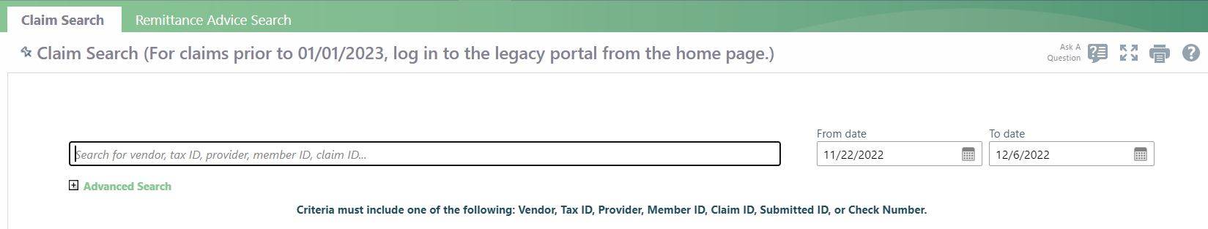
Claim Search
From this screen you will be able to click the + icon by the Advanced Search text and it will provide a more comprehensive list of ways to search for claims. This includes searching by vendor (group), tax ID, provider, member ID, claim ID, check number, billed amount, or claim type.
This will allow you to pull very specific claims or a broader range of claims.

Slide 40
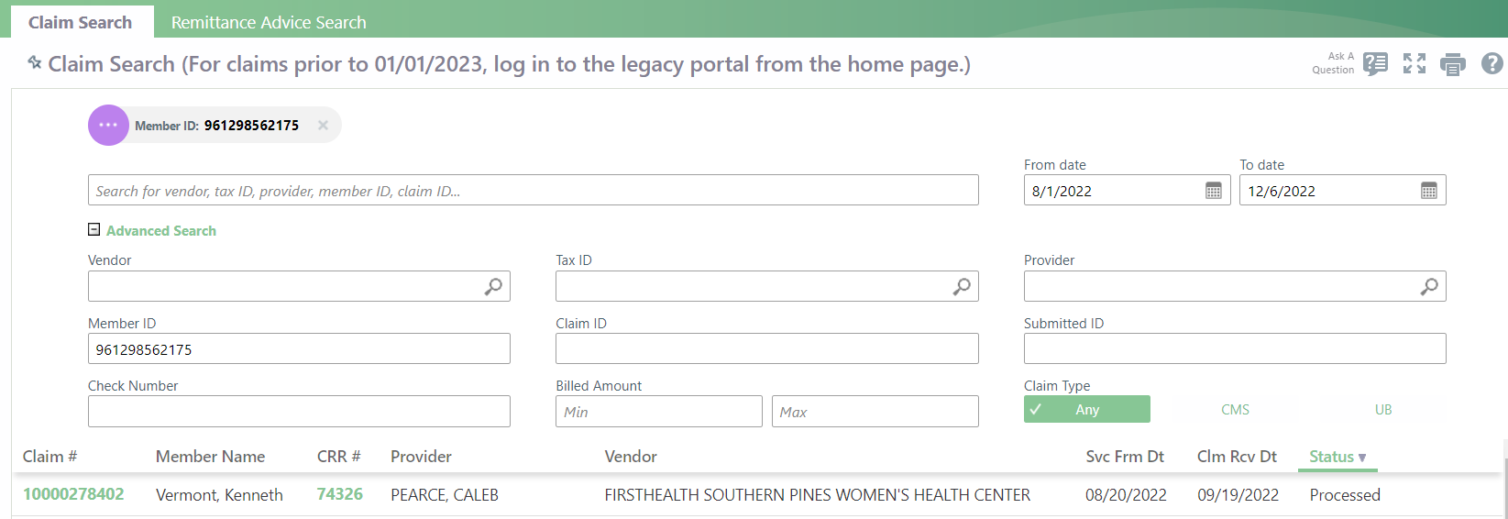
Claim Search
You will receive a list of claims that have been loaded with the search criteria you entered.
The claim hyperlink will then take you to claim details for that claim.

Slide 41
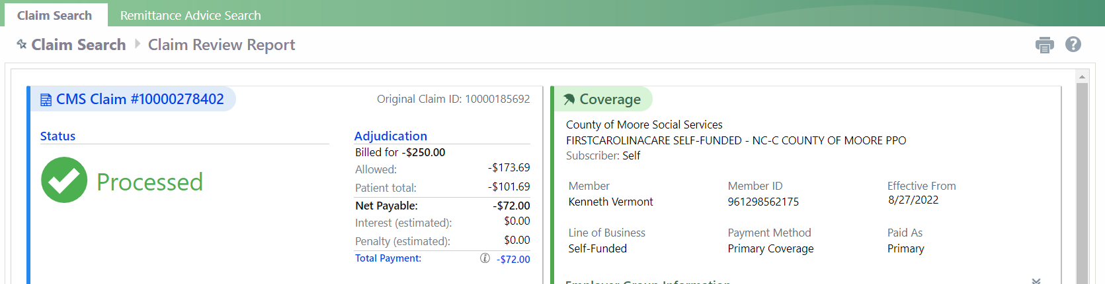
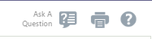
Claim Inquiries
There are multiple ways within Tapestry Link to submit a claim inquiry. The most efficient way is to utilize the Ask a Question icon at the top of the Claim Review Report screen that shows claim details.

Slide 42
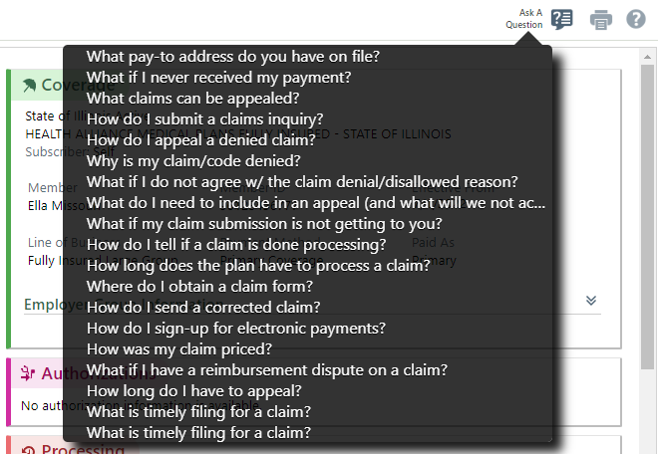
Claim Inquiries-cont’d
If you hover over the Ask a Question icon, you will get the following text box.
From there, you may choose
which option best suits your
inquiry.
Based on the option you
choose, it will be routed to the
correct department.

Slide 43
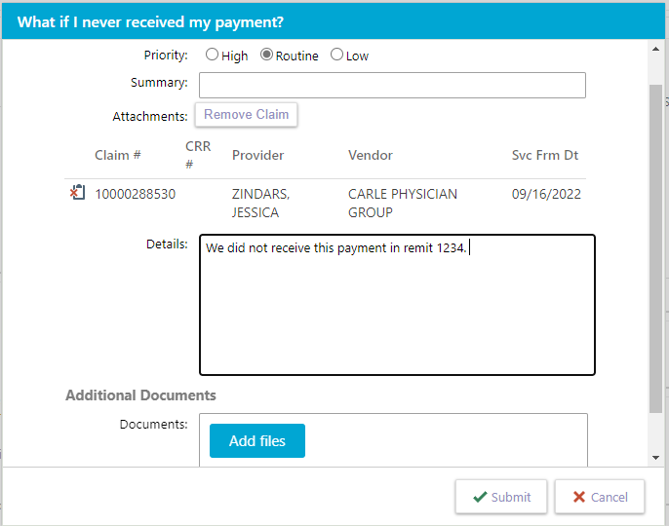
Claim Inquiries-cont’d
When you choose the option in the Ask a Question text box, you will get a screen that allows you to give details related to your inquiry and attach any documents that are pertinent to the inquiry.

Slide 44
Claim Inquiries-cont’d
In this inquiry screen, you will also notice the claim you are currently viewing is attached to the inquiry you are sending so you will not need to reference the claim number in your inquiry as it is already listed.

Slide 45


Claim Inquiries-cont’d
Once you have submitted your inquiry, you will receive a message indicating the claim has been received and a notification that the message has been sent successfully.
You will also receive a notification in your In Basket.

Slide 46
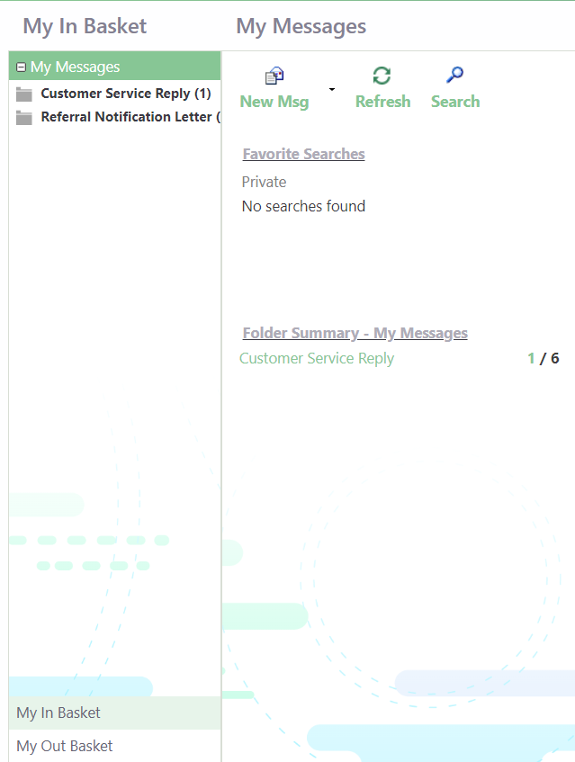
In Basket
Clicking on the In Basket icon in your toolbar will take you to your In Basket.
This is where you will find messages sent to you as well as messages you have sent.

Slide 47

In Basket
In your In Basket screen, you will have an area that is titled My Messages.
Here you will find your Folder Summary, which shows messages sent to you. The first bolded number is the number of unread messages and the second number is the total number of messages in your in basket.
Clicking the bold number
will take you directly to the unread messages.

Slide 48
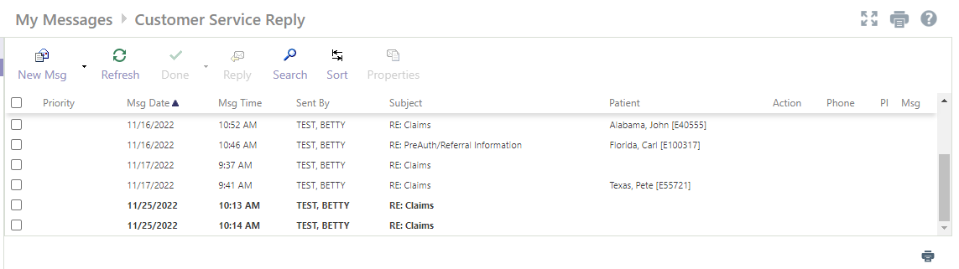
My Messages
In the My Messages-Customer Service Reply screen you will see all messages you have received from Customer Service.
You may sort this screen by any of the columns in this area.

Slide 49

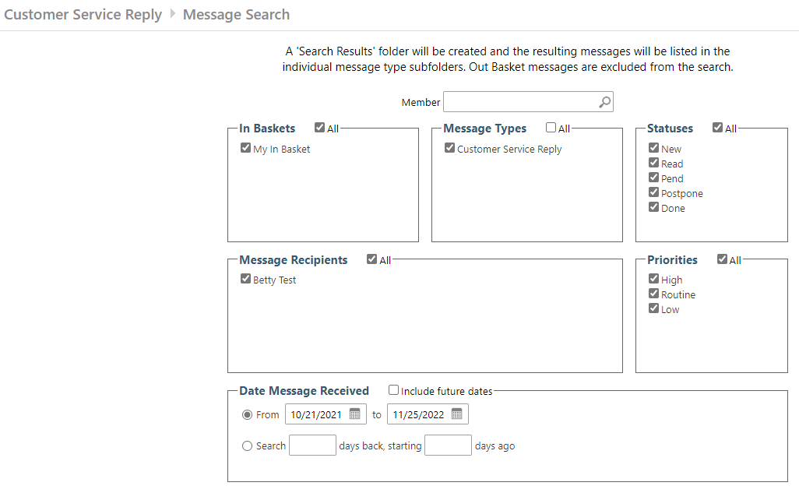
My Messages
You may also search within this screen by using the Search icon in the toolbar.
This will give many options for searching your messages, including by member.

Slide 50
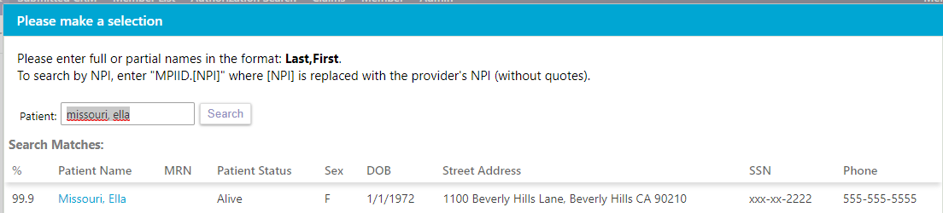
My Messages
By choosing to search by member, you will be asked for the patient’s name. You will then be able to choose the patient from the Search Matches.

Slide 51
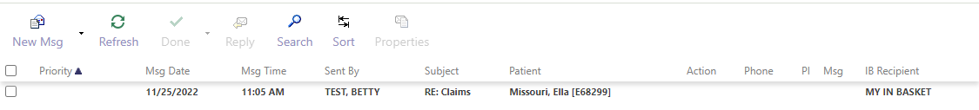
My Messages
Once you have selected the member, you will then click search and you will receive all messages related to that particular member.

Slide 52
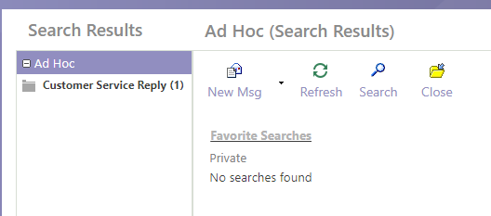
My Messages
To go back to all Customer Service Reply messages, you will need to highlight Ad Hoc and choose the Close icon on the associated screen.

Slide 53
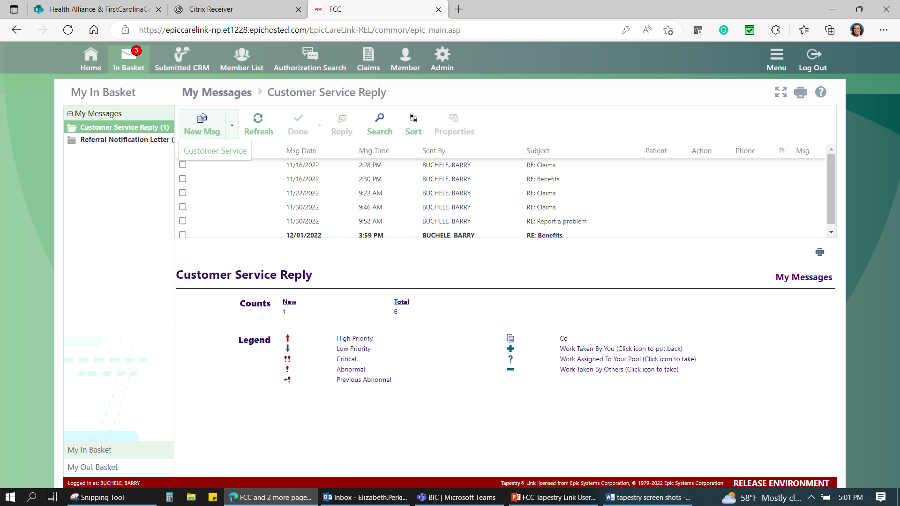
My Messages
From the My Messages-Customer Service Reply screen you may send a message directly to Customer Service. This is the preferred method of communication in Tapestry Link and will obtain the quickest results.
Choose Customer Service under New Msg to begin the communication.

Slide 54
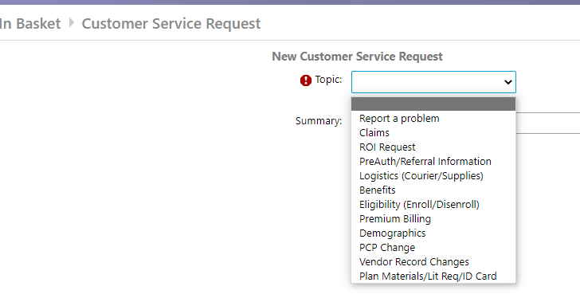
In Basket-Customer Service Request
Once you have initiated a Customer Service Request, you will be required to choose from a list of topics in this screen.
Please choose the option that is
closest to what you are inquiring
about. For example, choose Claims
for a claims question.

Slide 55
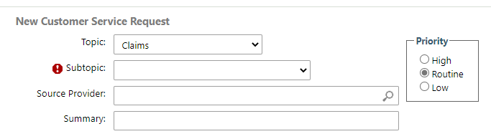
In Basket-Customer Service Request-cont’d
Depending on the Customer Service Topic you choose, you may be directed to choose a subtopic in the next screen.
In the subtopic area, you will also choose the option that best suits the inquiry.

Slide 56
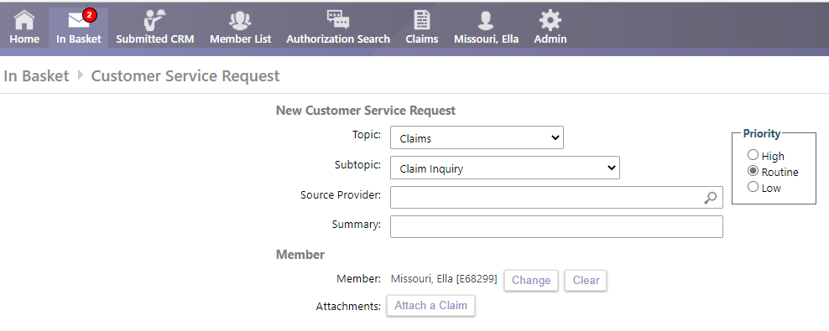
In Basket-Customer Service Request-cont’d
While in the New Customer Service Request screen you will note that you are attached to the member that you were originally attached to in the toolbar at the top of your screen. If this is not the intended patient, you would need to choose the Change option to choose a different member.

Slide 57
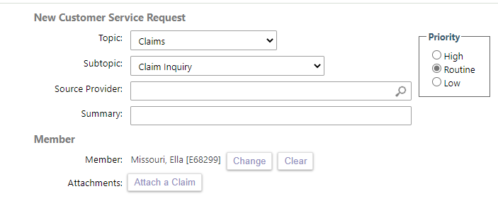
In Basket-Customer Service Request-cont’d
Within the New Customer Service Request, you may choose to Attach a Claim by choosing the Attach a Claim function.
You will then see claims for the member you are attached to. From that screen you may choose the claim you wish to inquire about.

Slide 58
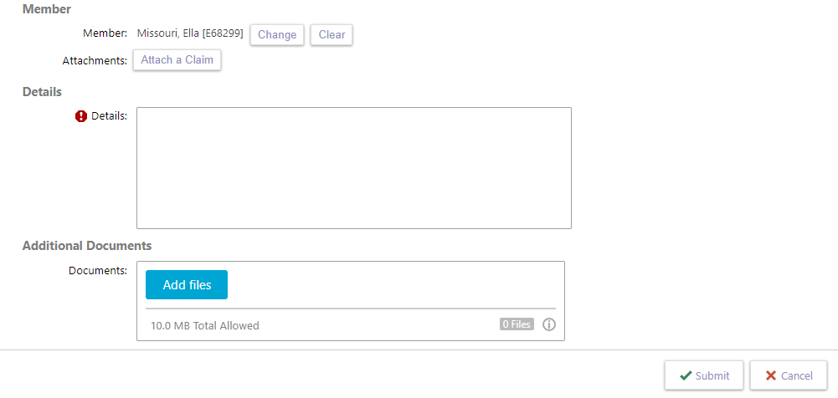
In Basket-Customer Service Request-cont’d
From the New Customer Service Request screen, you will be required to add details related to the inquiry. Please be as specific as possible.
You may also attach additional supporting documents if applicable.

Slide 59
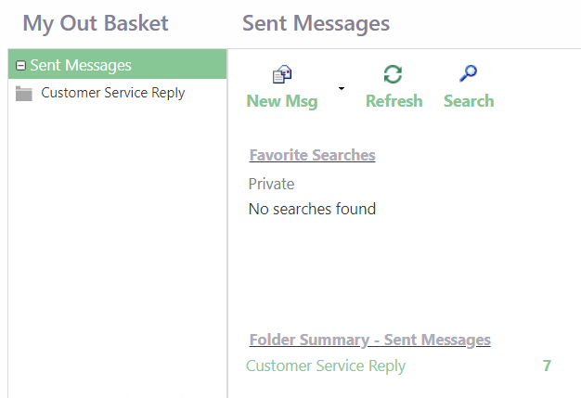
In Basket-Customer Service Request-cont’d
When you are in your Out Basket, you will be able to see all the Customer Service messages you have sent under the Folder Summary-Sent Messages area.

Slide 60
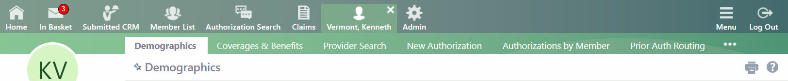
Prior Auth Routing
When attached to a member, you can request prior authorization for services by choosing the Prior Auth Routing tab in the toolbar.

Slide 61
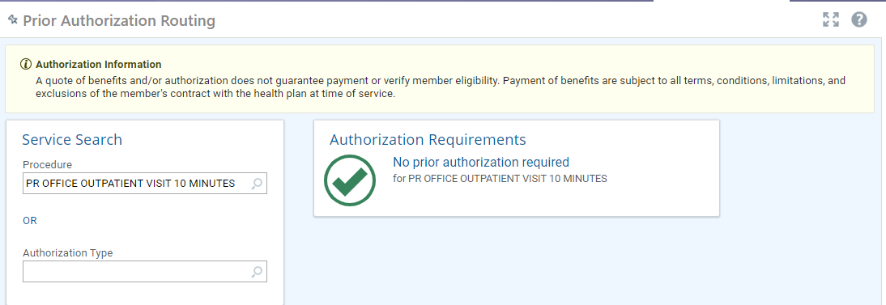
Prior Auth Routing-cont’d
Entering a Procedure code and choosing search will let you know if an authorization is needed and where to complete that authorization.
For codes that do not require authorization, it will show that No prior authorization is required.

Slide 62
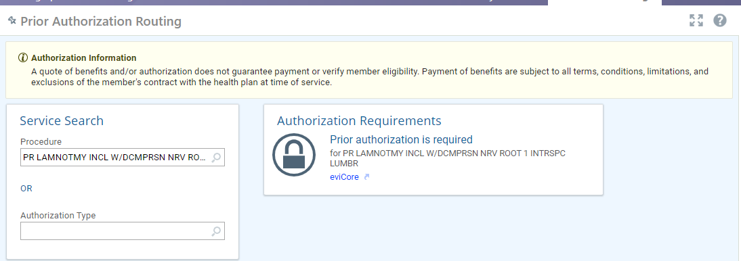
Prior Auth Routing
For codes that are required to be completed via eviCore, you will be shown a link to the eviCore site to complete the prior authorization there.

Slide 63

Prior Auth Routing
For pharmacy codes, you will be given a link to complete those authorizations in Guiding Care.

Slide 64

Prior Auth Routing-cont’d
For codes that go through Interqual, you will receive a link to complete a new authorization. The code used here is K0825 for a wheelchair.

Slide 65

Prior Auth Routing-cont’d
You will re-enter the code in the primary procedure code field at the bottom of the screen and click Next.

Slide 66

Prior Auth Routing-cont’d
In the next screen, you will fill in all fields with a red stop sign. You may search for options by clicking the magnifying glass in each box. Click Next when completed.

Slide 67

Prior Auth Routing-cont’d
Once you have clicked Next on the previous screen, two more fields will become available underneath the Referred To section. Once these fields have been completed, click Next.

Slide 68


Prior Auth Routing-cont’d
You will then enter the diagnosis code in the diagnoses field. You may enter additional diagnoses by clicking the add icon.
You may choose to attach documentation at this point by clicking Add File.

Slide 69

Prior Auth Routing-cont’d
You will now receive a link that will allow you to Launch InterQual. Clicking the link will take you to Change Health to complete the authorization.

Slide 70

New Authorization-cont’d
If InterQual Criteria is met, you will receive an immediate authorization approval.
If InterQual criteria was not met, you can choose Request Authorization to submit your request for review.

Slide 71


Prior Auth Routing-cont’d
If you are wanting to refer a patient to a provider that is not listed in the Provider Search results, you would choose the Authorization Type field and choose Consult and Treat.
From there, choose New
Authorization.

Slide 72


New Authorization
Once you have chosen New Authorization, you will then put the referral type in the next screen and choose next.

Slide 73

New Authorization-cont’d
In this screen, you will need to fill in any fields that have a red stop sign, as these are required fields.

Slide 74

New Authorization-cont’d
The provider you are referring to may be out of network and if so, you will receive a message box notifying you of this. You may click OK to continue to the next screen.
If it was not your intention to refer out of network, you may click cancel and return to the previous screen to find an in network provider.

Slide 75

New Authorization-cont’d
Once you have completed the required fields and clicked OK, you will then be prompted to choose the reason for the referral and fill in the comment field. You will then click Next.

Slide 76


New Authorization-cont’d
You will then need to enter the diagnosis in the Diagnoses field. If there are multiple diagnoses, you will hit the add icon to enter as many as needed.
From this screen you may also attach any documentation needed. Once you have completed this page, click Next.

Slide 77
New Authorization-cont’d
On this screen, if you need to make changes, you may use the Back button to go back.
You may use the Cancel Request button to cancel the request.
If you are ready to proceed with requesting the authorization, choose Request Authorization.

Slide 78

Authorizations by Member
When you are attached to a member, you may view the authorizations that have been submitted for that member by choosing the Authizorations by Member tab in the toolbar.
In this screen you will be able to click the ID and go directly to the authorization. You can also see status at a glance.

Slide 79

Authorization by Member-Auth Details
Once you have submitted the authorization, you will receive a page with authorization details. It will show referral #, status, the authorized from and to dates, diagnosis, and any comments you added to the authorization.

Slide 80


Authorization by Member-Auth Details-cont’d
You can also add additional notes/attachments to an existing Authorization Request by clicking the button at the top of the Authorization Detail screen

